Slide 1
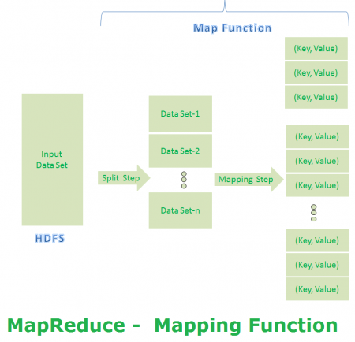
MapReduce Algorithm
Step 1

Slide 2
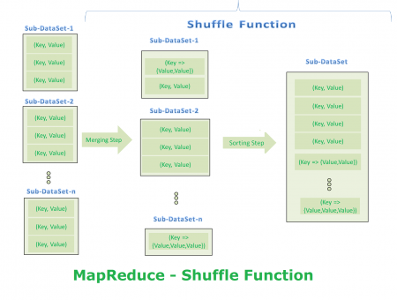
MapReduce Algorithm
Step 2

Slide 3
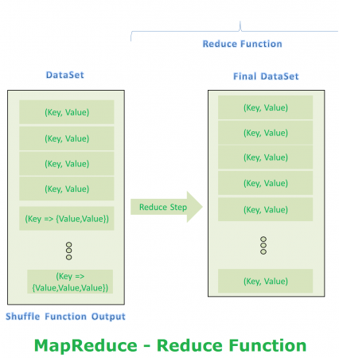
MapReduce Algorithm
Step 3

